Slide 1
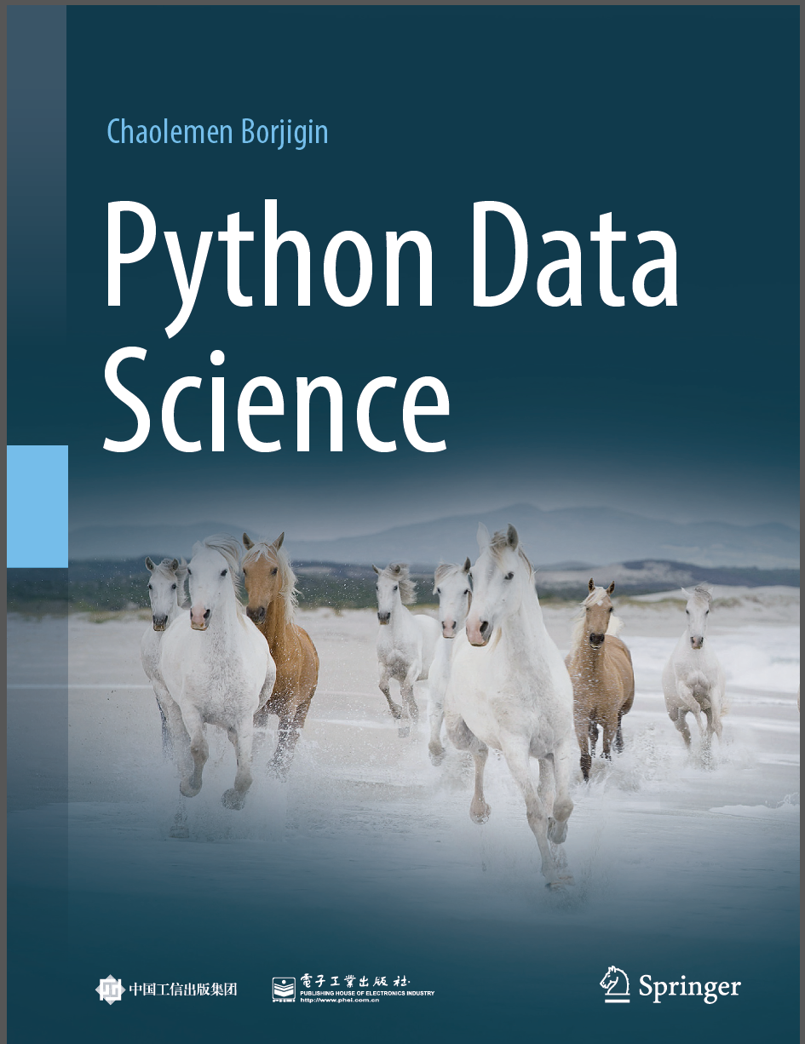
Python Data Science
Chaolemen Borjigin
Renmin University of China
chaolemen@ruc.edu.cn

Slide 2
2.17 Built-in functions
▼ Chapter 2 Basic Python Programming for Data Science
► 2.17 Built-in functions
Chaolemen Borjigin
Renmin University of China
chaolemen@ruc.edu.cn

Slide 3
Summary of this chapter
▼ Chapter 2 Basic Python Programming for Data Science
► 2.17 Built-in functions
2.17.1 Calling built-in functions
2.17.2 Mathematical functions
2.17.3 Type conversion functions
2.17.4 Other common used functions

Slide 4
2.17.1 Calling built-in functions
▼Chapter 2 Basic Python Programming for Data Science
► 2.17 Built-in functions
In[1]:
i=20
type(20)
dir(__builtins__)
Out[1]:
int

Slide 5
2.17.2 Mathematical functions
▼Chapter 2 Basic Python Programming for Data Science
► 2.17 Built-in functions
In[2]:
abs(-1)
Out[2]:
1
In[3]:
min([1,2,3])
Out[3]:
1
In[4]:
max([1,2,3])
Out[4]:
3

Slide 6
2.17.2 Mathematical functions
▼Chapter 2 Basic Python Programming for Data Science
► 2.17 Built-in functions
In[5]:
pow(2,10)
Out[5]:
1024
In[6]:
round(2.991,2)
Out[6]:
2.99

Slide 7
2.17.3 Type conversion functions
▼Chapter 2 Basic Python Programming for Data Science
► 2.17 Built-in functions
In[7]:
int(1.134)
Out[7]:
1
In[8]:
bool(1)
Out[8]:
True
In[9]:
float(1)
Out[9]:
1.0

Slide 8
2.17.3 Type conversion functions
▼Chapter 2 Basic Python Programming for Data Science
► 2.17 Built-in functions
In[10]:
str(123)
Out[10]:
'123'
In[11]:
list("chao")
Out[11]:
['c', 'h', 'a', 'o']

Slide 9
2.17.3 Type conversion functions
▼Chapter 2 Basic Python Programming for Data Science
► 2.17 Built-in functions
In[12]:
set("chao")
Out[12]:
{'a', 'c', 'h', 'o'}
In[13]:
tuple("chao")
Out[13]:
('c', 'h', 'a', 'o')

Slide 10
2.17.4 Other common used functions
▼Chapter 2 Basic Python Programming for Data Science
► 2.17 Built-in functions
In[14]:
i=0
type(i)
Out[14]:
int
In[15]:
isinstance(i, int)
Out[15]:
True

Slide 11
2.17.4 Other common used functions
▼Chapter 2 Basic Python Programming for Data Science
► 2.17 Built-in functions
In[16]:
dir()
Out[16]:
['In',
'Out',
'_',
'_1',
'_13',
'_14',
'_15',
'_16',
'_17',
'_4',
'_5',
'_6',
'_7',
'__',
'___',
'__builtin__',
'__builtins__',
'__doc__',
'__loader__',
'__name__',
'__package__',
'__spec__’,
……
]

Slide 12
2.17.4 Other common used functions
▼Chapter 2 Basic Python Programming for Data Science
► 2.17 Built-in functions
In[17]:
help(dir)
Help on built-in function dir in module builtins:
dir(...)
dir([object]) -> list of strings
If called without an argument, return the names in the current scope.
Else, return an alphabetized list of names comprising (some of) the attributes of the given object, and of attributes reachable from it.

Slide 13
2.17.4 Other common used functions
▼Chapter 2 Basic Python Programming for Data Science
► 2.17 Built-in functions
If the object supplies a method named __dir__, it will be used; otherwise the default dir() logic is used and returns:
for a module object: the module's attributes.
for a class object: its attributes, and recursively the attributes of its bases.
for any other object: its attributes, its class's attributes, and recursively the attributes of its class's base classes.

Slide 14
2.17.4 Other common used functions
▼Chapter 2 Basic Python Programming for Data Science
► 2.17 Built-in functions
In[18]:
myList=[1,2,3,4,5]
len(myList)
Out[18]:
5
In[19]:
range(1,10,2)
Out[19]:
range(1, 10, 2)

Slide 15
2.17.4 Other common used functions
▼Chapter 2 Basic Python Programming for Data Science
► 2.17 Built-in functions
In[20]:
list(range(1,10,2))
Out[20]:
[1, 3, 5, 7, 9]
In[21]:
callable(dir)
Out[21]:
True

Slide 16
2.17.4 Other common used functions
▼Chapter 2 Basic Python Programming for Data Science
► 2.17 Built-in functions
In[22]:
bin(8)
Out[22]:
'0b1000'
In[23]:
hex(8)
Out[23]:
'0x8'

Slide 17


